Slide 1

Cloud Based Technologies ITCFA1-33
Week 2

Slide 2
Learning Objectives
By the end of this lesson, students will be able to:
Describe the structure of AWS Global Infrastructure including Regions, AZs, Edge Locations, and more
Evaluate how location affects latency, availability, compliance, and performance
Identify AWS Global Edge Services and their use cases
Compare and explain key AWS compute and storage services
Interpret AWS pricing models and their cost implications
Calculate real-world AWS costs using provided data and tools
Apply cost optimization strategies using AWS services and monitoring tools
Recognize various AWS support plans and their relevance to different use cases
Engage in interactive reflection activities to apply knowledge practically

Slide 3
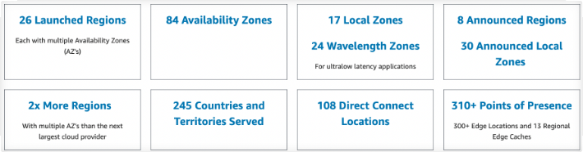
AWS Global Infrastructure
What is it? A global network of Amazon's data centers that powers cloud services.
Concepts:
Region = A city/country where AWS has data centers (e.g., Cape Town).
Availability Zones (AZs) = Independent data centers within a region.
Local Zones, Edge Locations, Wavelength Zones = For faster, nearby access to services.
Example:
A Region is a university campus.
AZs are the different buildings with their own electricity and Wi-Fi. If one building shuts down, others still work!

Slide 4
What is AWS Global Infrastructure?
Definition:
AWS Global Infrastructure is a worldwide network of data centers that deliver cloud services efficiently and reliably.
Key Parts:
Regions – Physical locations (like countries).
Availability Zones (AZs) – Data centers within regions (separate buildings).
Local Zones & Wavelength Zones – For ultra-fast, nearby access.
Current Stats:
102 AZs in 32 Regions
More coming soon in 🇨🇦 Canada, 🇲🇾 Malaysia, 🇳🇿 New Zealand & 🇹🇭 Thailand
Example:
When you upload a file to Google Drive or stream on Spotify, it’s stored in one of these AWS zones.

Slide 5
What is AWS Global Infrastructure?
Definition:
AWS Global Infrastructure is a worldwide network of data centers that deliver cloud services efficiently and reliably.
Key Parts:
Regions – Physical locations (like countries).
Availability Zones (AZs) – Data centers within regions (separate buildings).
Local Zones & Wavelength Zones – For ultra-fast, nearby access.
Current Stats:
102 AZs in 32 Regions
More coming soon in 🇨🇦 Canada, 🇲🇾 Malaysia, 🇳🇿 New Zealand & 🇹🇭 Thailand
Example:
When you upload a file to Google Drive or stream on Spotify, it’s stored in one of these AWS zones.

Slide 6
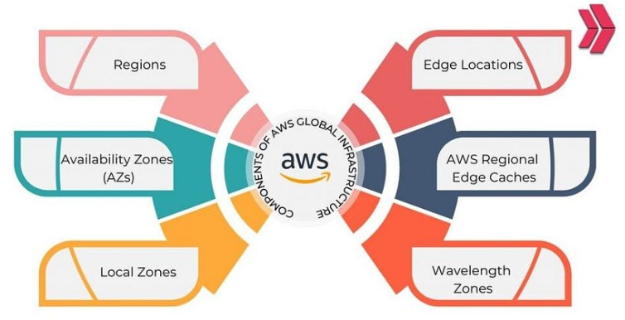
6 Key Components of AWS Global Infrastructure
What are the 6 components of AWS Global Infrastructure?
AWS uses different components to ensure its services are fast, reliable, and accessible worldwide.
The 6 Key Components:
Regions – Countries/locations with AWS services (e.g., Cape Town 🇿🇦)
Availability Zones (AZs) – Separate data centers in a region
Local Zones – For nearby low-latency service
Edge Locations – Store content closer to users (like Netflix caching videos)
Regional Edge Caches – Speed up frequently used content
Wavelength Zones – Power low-latency apps (like live sports streaming or gaming)
Which AWS component helps load a YouTube video faster — Region, AZ, or Edge Location?

Slide 7
What Are the Key Components of AWS Infrastructure?
AWS is built for global access, speed, and reliability.
Here are its 6 building blocks:
Regions – Large geographic areas (like Africa or Europe)
Availability Zones (AZs) – Data centers inside regions
Local Zones – For nearby access
Edge Locations – Deliver content fast (like YouTube)
Regional Edge Caches – Store frequently accessed data
Wavelength Zones – Power real-time apps (like Uber or gaming)

Slide 8
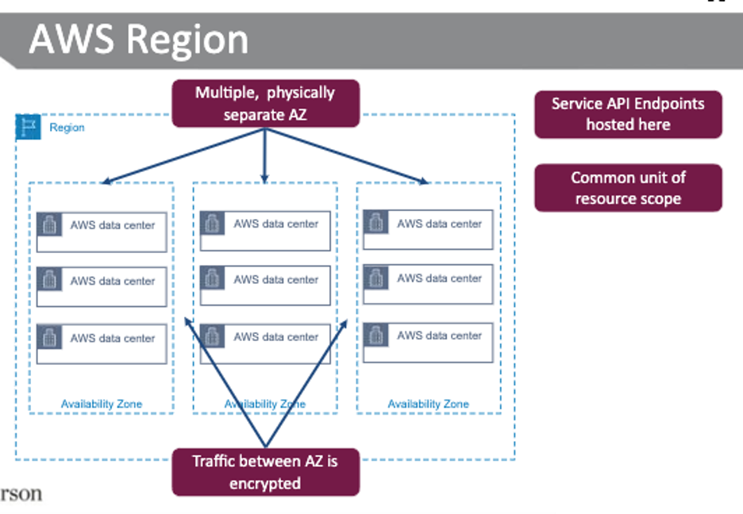
What is an AWS Region?
An AWS Region is a physical location in the world where AWS clusters data centers. Each Region has at least 3 Availability Zones (AZs).
Key Features of Regions:
Fully isolated from other regions
Supports data replication for backups
Helps with data privacy laws (e.g., storing data only in SA)
You choose the Region when launching services (like EC2)
Example: If you're a South African business using AWS, you might choose the Cape Town region to keep data local and fast.

Slide 9
Discussion: Using AWS Regions Strategically
Scenario:
You're developing a student app that allows learners to stream lectures, download notes, and interact with each other in real time. Your users are based in both South Africa and Europe.
Question
How would you use AWS Regions wisely to make sure:
All students experience fast and smooth performance?
Their data stays secure and within their region (to follow laws like GDPR)?
The app stays online and responsive, even if something fails in one region?

Slide 10
What is an AWS Availability Zone (AZ)?
An Availability Zone (AZ) is a physically separate data center within an AWS Region. Each AZ has its own:
Power supply
Cooling system
Networking
Why AZs matter:
Provide resilience – if one AZ fails, another keeps running
Help with disaster recovery
Improve performance when used together
Example: If your university had multiple computer labs in different buildings, and one went down due to a power failure — students can still access others. That’s how AZs work!

Slide 11
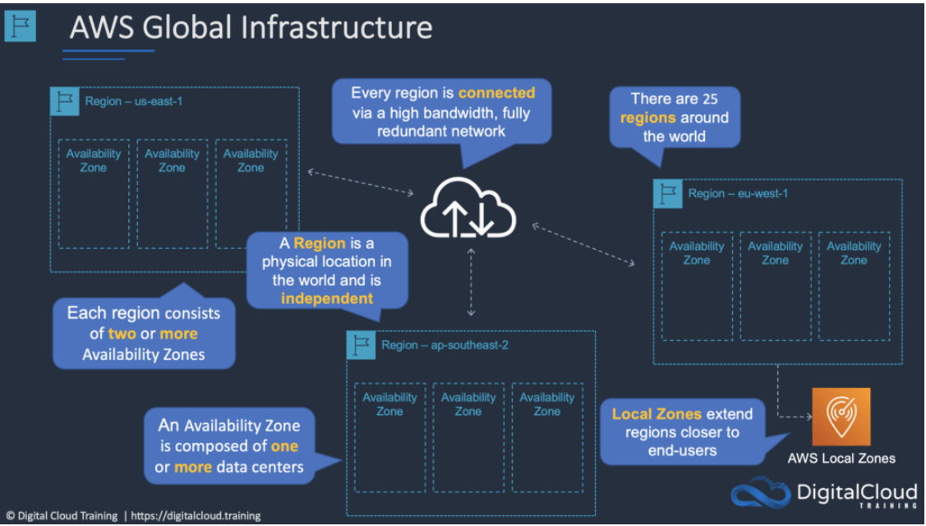
How AZs Ensure High Availability?
Key Features:
AZs are independent failure zones
Connected with low-latency, high-speed networks
Spread across a metro region but far enough to avoid shared risks (like flooding)
Practical Uses:
Launch EC2 instances in different AZs for failover
Use Elastic IPs to reroute traffic if one instance fails
AZs are named differently per account (e.g., us-east-1a might differ for each user)
Use AZ IDs to match zones across accounts

Slide 12
Scenario Based Question
Scenario:
You’re launching a web app for your campus. You deploy the backend server in us-east-1a, and it suddenly crashes.
Think-Pair-Share:
What steps can you take using AWS Availability Zones to:
Keep the app running without students noticing?
Avoid losing user data?
Hint:
Use multiple AZs for redundancy
Set up automatic failover between Azs
Use Elastic IPs to reroute traffic instantly

Slide 13
AWS Data Center Locations – Global View
What is a Data Center Location? An AWS data center location is a physical facility where cloud resources (servers, storage, etc.) live.
AWS is present on every major continent through:
Regions: Countries or areas with AWS presence
Availability Zones: Independent, isolated facilities within a region
Edge Locations: Bring data closer to users for speed
Regional Edge Caches: Boost performance for repeated content
AWS has over:
30+ Regions
100+ Azs
300+ Edge Locations globally!

Slide 14
AWS Locations by Continent
Europe / Middle East / Africa (EMEA)
11 Regions | 33 AZs | 39 Edge Locations
🇿🇦 Cape Town (3 AZs), 🇦🇪 UAE, 🇬🇧 London, 🇪🇸 Spain...
North America
7 Regions | 25 AZs | 44 Edge Locations
🇺🇸 N. Virginia (6 AZs), Ohio, Oregon, California...
Asia Pacific + China
12 Regions | 38 AZs | 34 Edge Locations
🇸🇬 Singapore, 🇯🇵 Tokyo, 🇮🇳 Mumbai, 🇨🇳 Beijing...
South America
1 Region (🇧🇷 São Paulo) | 3 AZs | 4 Edge Locations
Note: Each AZ has its own power and network — designed to stay up even if others fail.

Slide 15
Class Activity – Find the Nearest AWS Center
You’re launching an app for university students in:
🇿🇦 South Africa🇪🇸
Spain🇯🇵
Japan
Your task:
Pick an AWS region for each country
Explain why that region is ideal (speed, compliance, reliability)
Share with the class
Hint:
Choose regions with multiple AZs and Edge locations nearby for better performance!

Slide 16
What are AWS Local Zones?
AWS Local Zones bring cloud services closer to users in major cities for apps that need very low latency (fast response).
Key Points:
An extension of an AWS Region in specific metro areas
Great for real-time apps: gaming , live media , financial systems Offers compute, storage, and networking close to users
Supports millisecond-level performance
Example:
A gaming company in Los Angeles uses a Local Zone so players don’t experience lag during live gameplay.
Connects seamlessly with full AWS Region services using the same tools and APIs.
Why do you think financial apps (like mobile banking) would benefit from AWS Local Zones?

Slide 17
What is an AWS Edge Location?
An Edge Location is a data center that caches content (like images or videos) close to users, helping websites and apps load faster.
Used by Amazon CloudFront (a Content Delivery Network - CDN) Think of it as a local copy station of your website’s content!
Why It Matters:
Speeds up delivery by reducing distance to users
Handles requests for static content (e.g., web pages, product images)
If content isn’t there, it’s pulled from the origin server (like S3) and cached for the next user
Example: When you watch Netflix, the preview image you see is likely loaded from an Edge Location near you!

Slide 18
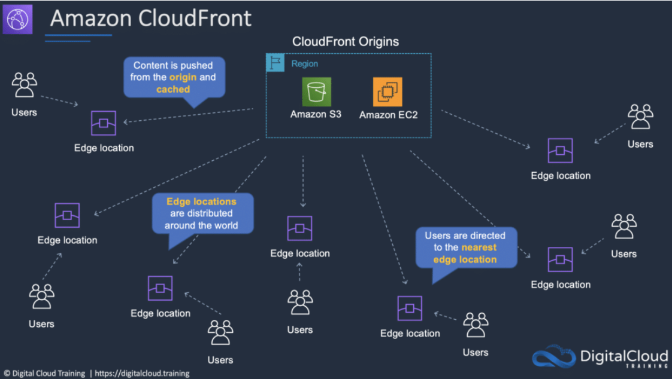
What Are Regional Edge Caches?
Regional Edge Caches = a middle layer between:
The origin server (e.g., S3 or EC2) and
The Edge Locations
Key Features:
Store content that is less popular but still accessed
Larger cache size than normal edge locations
Help offload traffic from origin and speed up delivery
Great for:
News articles
E-commerce product images
Viral content or trending posts

Slide 19
Why Use Edge Locations?
Scenario: You’re launching an online store for your campus. Students are complaining that page's load slowly when accessing the store from different provinces.
Discussion Questions:
How can Edge Locations and Regional Edge Caches help solve this?
Why might caching content near users be better than loading it from one central server?
Which content should be cached, and which should always be live?
Hint: Think about frequently viewed content like product images or banners.

Slide 20
What Are AWS Wavelength Zones?
Wavelength Zones bring AWS cloud services to the edge of 5G networks, allowing apps to respond almost instantly.
Why Use It?
Supports real-time apps that need ultra-low latency, like:
Gaming
AR/VR
Live video streaming
Connected cars
How It Works:
Hosted inside telecom provider data centers near 5G towers
Direct link between AWS and mobile devices
Delivers response times in single-digit milliseconds
Example:
An AR shopping app uses Wavelength Zones, so virtual products appear in real time as you move your phone

Slide 21
What is AWS Outposts?
Definition: AWS Outposts bring AWS cloud services directly to your own data center or building.
Why Use It?
For apps that need to stay on-site (due to latency or security)
Works just like AWS Cloud – same APIs, tools & services
Ideal for hybrid cloud setups (mix of on-prem + cloud)
How It Works:
Outposts = Real AWS hardware installed in your location
Connects to AWS via VPN or Direct Connect
AWS handles all software updates and patching
Example: It’s like having a mini-AWS data center in your building, with AWS still managing it for you.

Slide 22
What Can You Do with AWS Outposts?
Services You Can Run On-Premises:
EC2 (servers)
ECS & EKS (containers)
S3 (storage)
RDS & EMR (databases & analytics)
Outpost Hardware Options:
Small 1U or 2U servers for tight spaces
Full 42U racks for bigger workloads
Scales up to 96 racks!
Security & Connectivity:
Use PrivateLink to connect securely to AWS services
Data stays local, but still interacts with AWS Cloud
Why might a hospital or bank prefer using AWS Outposts instead of fully moving to the cloud?

Slide 23
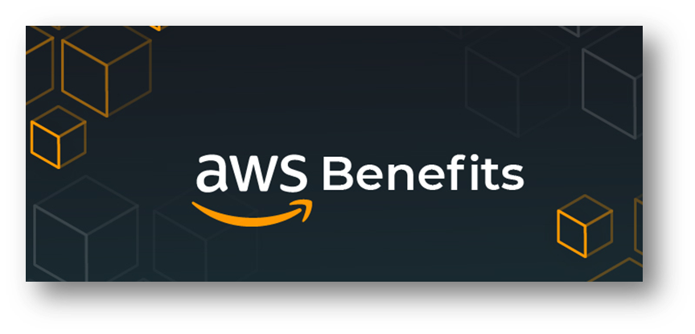
Benefits of Cloud Computing
Cost Savings
Shift from capital expenditure (CapEx) to operational expense (OpEx)
Pay only for what you use
Economies of scale reduce overall IT costs

Slide 24

Types of Cloud Computing Services
SaaS delivers fully functional software applications over the internet
Characteristics
No installation or maintenance required
Accessible from any device with internet
Delivered on a subscription basis
Benefits:
On-demand usage and accessibility
Supports remote collaboration
Automatic software updates
SaaS
(software as a service)

Slide 25
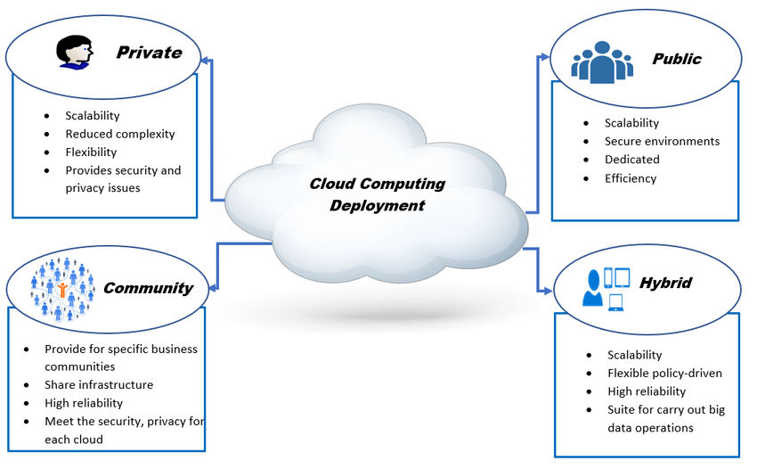
Cloud Deployment Models

Slide 26
QUESTIONS?

